Slide 1

MODULE D
Group 1 — Settling In & Belonging | L3 and T Level Digital, Media, Film and Computing
Students' Voice
& Student Rep
Elections
You're training for industry — placements, employer briefs, live products. This is how you get a say in how that training runs.
100 minutes
BTEC Level 3 / T-Level
PROUD value: Encourage Unity | Eastbourne · Lewes · Hastings (Station Plaza & Ore)
Notes:
SLIDE 1 — TITLE
Mode: TEACHER INPUT | Variant: L3 Year 2 / A-level Year 2
Do not use this deck with new starters. This variant is calibrated for students who have been at ESCG for at least one year.
The subtitle — 'You know how this works. Now decide what you do with that.' — sets the register. This isn't induction. It's a check-in and a decision point.
Two subgroups to hold in mind:
L3 Year 2: Last year of their Level 3. Don't fumble the last lap. They have enough institutional knowledge to stand for Rep or Governor with genuine credibility.
A-level Year 2: UCAS is live or imminent. Time is finite. Rep role is still real and worth taking on; Governor election in November is less relevant (most will have left before they could serve a full term — flag this in speaker notes context on slide 7).
PROUD value: Encourage Unity. The returner framing: 'You've seen collective voice work or not work. You're the ones who know how to make it work this year.'
DEPARTMENT VERSION — this deck has been personalised for Year 1 Level 3 and T Level Digital, Media, Film and Computing (Content Creation and Cybersecurity & Digital Systems at Eastbourne; Games Art and Animation at Station Plaza; Film Production and the Digital and Cyber Security T Levels at Ore; Creative and Design T Level at Lewes). Five things still need your local detail: campus and group, the English and maths class times and teachers, where the Governor application link lives, who holds the Student Rep Register for your area, and one real example of something that changed here because students asked.
NEW THIS YEAR: this group elects TWO reps — one for their course, one for their English and maths class. Both go on the central Student Rep Register today.
Register note: this is a vocational L3 group. The productive frame throughout is professional conduct — speaking up, evidencing a concern, following it through — because it is the same behaviour their placement or employer will assess.

Slide 2







What we're doing today
SESSION MAP
About 100 minutes — the shape of the session
1
2
3
4
Check in
Students' Voice
Ways to get involved
The Rep role
What would you change about your course? (10 mins)
What makes it work — and what doesn't (10 mins)
Reps, Governors, NUS, surveys (10 mins)
What reps do and when (10 mins)
5
6
7
8
The Governor role
Encourage Unity
Election
Close
The Board, the commitment, how to apply (15 mins)
PROUD value anchor (5 mins)
Nominations, pitches, vote — course rep + English/maths rep (30–35 mins)
Your rep, what's next
Module D — Students' Voice & Student Rep Elections | L3 & T Level Digital, Media, Film and Computing
Notes:
SLIDE 2 — SESSION MAP
Mode: SESSION MAP | Time: 1 min
Returners don't need a detailed walkthrough — they know the format. Keep this to 30 seconds.
The one thing to flag: 'Today ends with an election. Whether or not you want to stand, pay attention to the earlier slides — you know what makes a good rep better than first-years do.'
NOTE — two seats are filled in the election slot: the course rep and the English/maths rep.

Slide 3
Check in
DISCUSSION
Paired discussion — 10 minutes
What's one thing about the studios, the software or the placement process that would be different if students had been asked?
What would you want your rep to take to Student Council — software licences, edit time, kit availability, placement support?
Talk to the person next to you — 3 minutes, then we'll hear a few thoughts from the room.
Module D — Students' Voice & Student Rep Elections | L3 & T Level Digital, Media, Film and Computing
Notes:
SLIDE 3 — CHECK IN
Mode: DISCUSSION | Time: 10 mins
Two questions, not one. The first is analytical — what actually happened? The second is forward-looking — what would you want to be different? Together they establish that this group has the experience to make the election today meaningful.
Running it: 3 minutes paired, then invite 4–5 responses. Don't editorialise — note the themes briefly. The punchline: 'You've just described what a good rep looks like. Keep that in mind when you're voting — or standing — later.'
What to watch for: students who say 'I never knew who our rep was' or 'they never fed back.' These are valid critiques. Acknowledge them directly — 'That's exactly the gap this year's election can fix.' Don't get defensive.
L3Y2 specific: some may be genuinely energised by the start of a new year. Others may be coasting. The two-question format tends to surface both.
A-level Y2 specific: UCAS pressure may be visible already. Acknowledge at close of discussion if relevant: 'I know some of you are already deep into applications. That's exactly why having a rep who understands the pressure you're under matters.'
Safeguarding: open questions occasionally surface concerns. Listen calmly, do not promise confidentiality, report same day. Module F covers full procedure.
NOTE — both check-in questions now name this department's working environment: studios, software, edit time, kit and the placement process. The more concrete the question, the more usable the feedback the rep carries to Council. Push once for the named thing — “four edit stations can't run Premiere” is usable at Council; “the software is rubbish” is not.

Slide 4


Students' Voice — what makes it work
TEACHER INPUT
What makes student voice actually work — and what wastes it
When it works
Teaching & Learning
Student experience
Reps who actually consult their group — not just improvise at meetings
Feedback that names the thing — “four edit stations can't run Premiere” beats “the software is rubbish”
Groups who tell their rep what matters — before the meeting, not after
Students who follow up — checking the licence actually arrived, or the kit was actually booked
Curriculum and delivery shaped by what students report — which units run when, how placement weeks fall
Campus life improved by evidenced feedback — studio access, edit time, travel between campuses
Community
Visible outcomes
Staff and students agreeing what “industry-ready” actually means on this course
You can see what changed — and what's still being worked on
Collective voice is a shared responsibility — not just the rep's job
Module D — Students' Voice & Student Rep Elections | L3 & T Level Digital, Media, Film and Computing
Notes:
SLIDE 4 — STUDENTS' VOICE Mode: TEACHER INPUT | Time: 10 mins Purpose: move the conversation from 'what is this' (which returners already know) to 'what makes it actually work.' This is a more sophisticated framing than Core's introductory slide. The left panel names the four conditions for effectiveness. Each one is worth a sentence — draw on what the check-in discussion surfaced. If the group said their rep 'never fed back,' that maps directly to the third bullet ('groups who tell their rep what matters'). The honest case: 'Students' Voice doesn't work automatically. It works when the rep is genuinely plugged in, and when the group uses them. Both sides of that have to function.' Don't over-promise outcomes — returners will call it out if you do. The 'visible outcomes' card is the important one: outcomes are documented and visible, even when they're partial or slow. Bridge: 'So — knowing all that — let's look at the roles available and which one might suit where you are this year.'

Slide 5
Ways to get involved
TEACHER INPUT
Four ways in — pick the one that fits
Student Rep
Two elected today
Student Governor
Apply by 16 Oct
Elected today. You speak for this group at Student Council — and you elect a rep for your English and maths class too.
3 places on the Main Governing Board — where studio, kit and software investment gets decided. Applications close midday, Friday 16 October — see slides 7–10.
NUS Membership
You're already in
Surveys & Forums
From 3 Nov
You're already a member. TOTUM card (£14.99/year) gives discounts across hundreds of retailers — worth checking before you buy a drive, headphones or software.
Induction Survey opens 3 November. Three minutes — the place to report a software, kit or placement problem while there is still time to fix it.
Module D — Students' Voice & Student Rep Elections | L3 & T Level Digital, Media, Film and Computing
Notes:
SLIDE 5 — WAYS TO GET INVOLVED Mode: TEACHER INPUT | Time: 10 mins Returners don't need each option explained from scratch. The framing question — 'which one fits Year 2?' — is the right lens. Student Rep: 'You've seen what a rep does, and you probably have views on what makes a good one. That knowledge is exactly what makes you a stronger candidate than you were last year.' Student Governor: note the forward flag — 'requires commitment beyond this year.' A-level Y2 students who are leaving after this year are not eligible to serve a full Governor term. Flag this without making it a barrier: 'If you're continuing at ESCG, this is worth looking at seriously in November.' Induction Survey: 'Three minutes, and it's how the college gets a picture of what Year 2 actually looks like from the inside. Worth doing even if you do nothing else today.'

Slide 6

The Student Representative role
TEACHER INPUT
What the role involves — and what you get out of it
What reps do
Student Council meetings 26/27
Gather and convey student opinions to college leadership
Attend 3 Student Council meetings per year (dates on the right)
Provide feedback on teaching, studios, edit suites, kit and software licences
Work with staff to develop solutions — not just present problems
Keep the group informed after every meeting
Represent this group in your English and maths class too
Campus | Council 1 | Council 2 | Council 3
Eastbourne | Wed 11 Nov | Mon 15 Mar | Wed 5 May
Lewes | Tue 10 Nov | Wed 17 Mar | Wed 5 May
Station Plaza | Thu 12 Nov | Mon 15 Mar | Tue 4 May
Ore Valley & ATIC | Tue 10 Nov | Wed 17 Mar | Wed 5 May
Rep training: Wednesday 14 October (all campuses)
Employers notice this: it is evidence of communication, negotiation and professional conduct.
Training is expected for all newly elected reps. Flag it now if 14 October clashes with a placement day or a studio deadline.
Develops: communication, leadership, problem-solving, and employability skills
Module D — Students' Voice & Student Rep Elections | L3 & T Level Digital, Media, Film and Computing
Notes:
SLIDE 6 — THE STUDENT REP ROLE
Mode: TEACHER INPUT | Time: 10 mins
The returner-specific framing is in the green tinted strip: 'Year 2 advantage — you know the staff, the meetings, and what actually moves things.' Say this directly.
Familiarity-as-risk is the thing to name honestly: 'The risk in Year 2 is that you know the system well enough to go through the motions. A rep who's coasting doesn't help anyone.' Pair it immediately with the positive: 'But knowing the system also means you can make it work faster than a first-year can. That's a genuine advantage.'
Training note: even returners who have been reps before are expected to attend the 14 October training as newly elected reps. It's not optional — flag this clearly.
A-level Y2 specific: for students with UCAS pressure, acknowledge the time cost honestly. 'Three meetings a year. If you're managing UCAS alongside this, it's manageable — but it requires being organised. Don't stand if you can't commit.'
NOTE — the sixth bullet is new: the rep role now covers the group's English and maths class as well as the course. Both reps attend the same 14 October training.

Slide 7
The Student Governor role
TEACHER INPUT
A different role — and a serious one
What Student Governors do
Who can apply
Full-time students and apprentices (part-time considered)
Planning to study at ESCG for at least one more year — Year 2 of this course counts
Enthusiastic about sharing opinions on how the college is run
Willing to act as a link between the Board and the student body
3 places on the Main Governing Board — strategic decisions about the whole college
Represent authentic student experience — what an industry placement or an employer-set brief is actually like
Contribute to decisions on curriculum and budget — software licences, studio kit, where investment goes
Exceptional leadership experience — genuinely CV-worthy at this level
You must be planning to study at ESCG for at least one more year. If this is your final year, speak to your Student Enrichment Co-ordinator before applying.
Different from Student Rep — strategic scope, institutional weight
Applications close at midday on Friday 16 October — the next three slides show the process.
Module D — Students' Voice & Student Rep Elections | L3 & T Level Digital, Media, Film and Computing
Notes:
SLIDE 7 — STUDENT GOVERNOR ROLE Mode: TEACHER INPUT | Time: 5 mins The A-level Y2 eligibility note is on-slide for this variant — it prevents students from investing enthusiasm in an option that isn't available to them. Say it directly: 'If you're finishing A-levels this year and not continuing at the college, the Governor role isn't open to you. That's not a criticism — it's just the requirement.' For L3Y2 students who are progressing: this is worth pressing before the 16 October deadline. 'You've already got a year here. You know how this college works. That's exactly the kind of experience a Governor needs.' Student Enrichment Co-ordinators for students who want to find out more: • Eastbourne: Chelsey King • Lewes: Tessa Echalaz • Station Plaza & Ore Valley: Paige Baker-Carroll Bridge: 'One more thought before we get to the election.'

Slide 8
What the Board does — and where a Governor sits
TEACHER INPUT
Strategic governance, not day-to-day management
What the Board is responsible for
Where a Student Governor sits
Brings the student perspective into Board discussion — such as whether the kit here matches what employers actually use
Helps Governors understand lived student experience
Asks questions and offers constructive challenge
Acts in the interests of the whole College community
Setting the strategic direction of the College
Monitoring performance and quality
Overseeing finances, estates and resources — studios, edit suites, cameras and software licences
Ensuring students receive an excellent experience
Holding senior leaders to account
Student Governors provide a student perspective — they are not elected to represent a course, campus or student group. That is the Student Rep's role.
Governors do not manage the day-to-day running of the College.
Three places: Eastbourne, Hastings & Ore Valley, Lewes & Newhaven. Open to FE, HE and Adult Learning students.
Module D — Students' Voice & Student Rep Elections | L3 & T Level Digital, Media, Film and Computing
Notes:
SLIDE 8 — WHAT THE BOARD DOES
Mode: TEACHER INPUT | Time: 4 mins
The distinction in the red box is the content of this slide: a Student Governor brings a student perspective; they are not a representative. The nearest workplace parallel is a board director versus a union rep — for groups already on placement, that comparison usually lands first time.
Both mechanisms are real. The rep is accountable to this group; the governor is appointed for what they bring.

Slide 9
What it takes — and what you get
TEACHER INPUT
Roughly 3–5 hours a month, across the academic year
The commitment
3–5 hrs/month
The work itself
Real influence
4 Board meetings a year (2–3 hours each), around 3 committee meetings, 2 strategy days, plus reading papers in advance. It has to fit around placement blocks, assignment windows and employer project deadlines.
Termly Student Governor reports to the Board and presentations to committee — on topics such as sustainability and green skills, AI, careers advice and College values. Whether kit and software keep pace with industry belongs on that list too.
Support provided
Induction + training
Is it for you?
No experience needed
Induction with the Director of Governance, ongoing training, Governor portal and iPad, expenses reimbursed, an annual 1:1 with the Chair.
Reliable, prepared, comfortable asking questions in a room of adults, able to handle confidential information — which you already do on placement and when you hand work to a real audience. Strong evidence for UCAS, apprenticeship and employer applications.
Module D — Students' Voice & Student Rep Elections | L3 & T Level Digital, Media, Film and Computing
Notes:
SLIDE 9 — WHAT IT TAKES
Mode: TEACHER INPUT | Time: 4 mins
Be concrete about the time, especially for groups with placement blocks — 3–5 hours a month is real and Board dates are fixed a year ahead.
Card 4 is the one to dwell on: confidentiality, preparation and professional conduct are things this group is already assessed on in the workplace. Name that transfer explicitly.

Slide 10

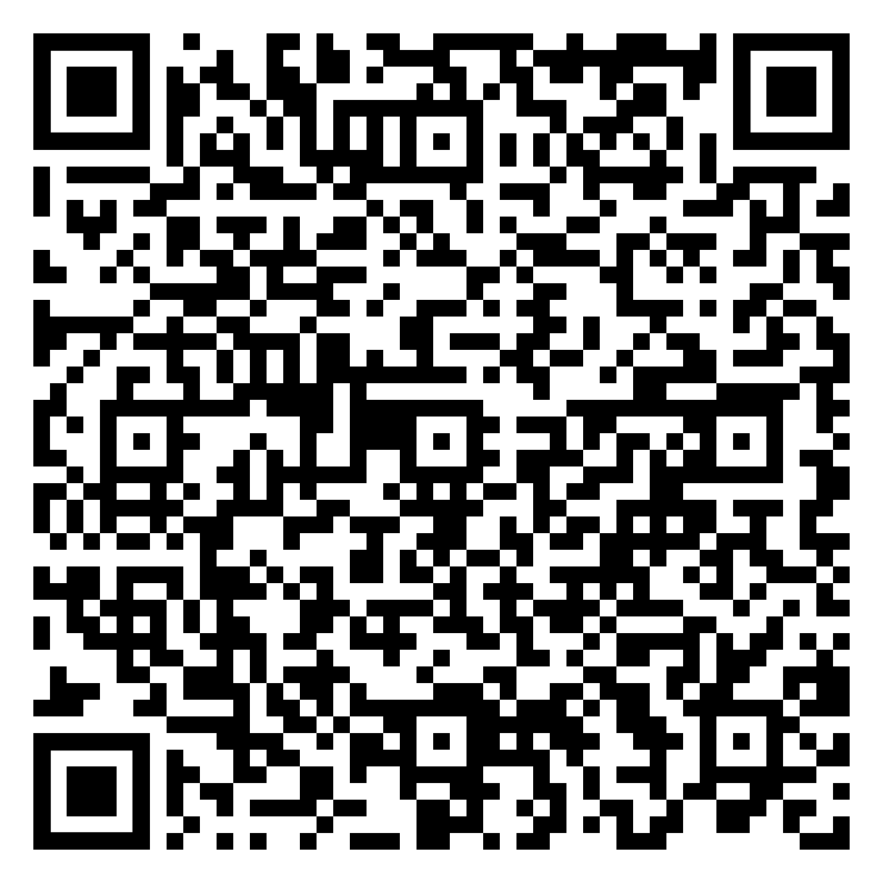
How to apply
TEACHER INPUT
Applications close at midday on Friday 16 October
1
2
3
4
Application
Governor discussion
Student ballot
Appointment
Submit the online nomination form. Deadline: midday, Friday 16 October.
Please scan to access the application form
An informal conversation about your interest, the commitment and what you'd bring. 2–5 November. It is not an interview and does not need preparing for like one.
Held where more candidates apply than there are places. 9–23 November.
Committee recommendation on 24 November; formal Board appointment on 14 December.
Deadline
midday, Fri 16 Oct
Strong applications are specific: why improving the College matters to you, an example of leadership or influence — leading a shoot, running a project schedule, sorting a problem on placement — and evidence you will prepare and turn up.
Questions? Belle Howard, Director of Governance — Belle.Howard@escg.ac.uk
Module D — Students' Voice & Student Rep Elections | L3 & T Level Digital, Media, Film and Computing
Notes:
SLIDE 10 — HOW TO APPLY
Mode: TEACHER INPUT | Time: 4 mins
The deadline — midday, Friday 16 October — is the operative fact.
Eligibility: students must be planning to study at ESCG for at least one more year. For final-year groups, redirect to the Rep role rather than letting them draft an application that cannot proceed.

Slide 11


PROUD VALUE
Encourage Unity
One person's complaint is an opinion. A group saying the same thing is evidence — and evidence is what changes decisions. One person waiting for a camera is bad luck. A whole cohort waiting is evidence.
On placement and in the studio you already spot what isn't working — you flag a fault on a shoot without being asked. Do the same here.
A rep you helped choose is a rep who'll listen when you tell them what matters — like edit stations that can't run the software your assignment needs.
The group that engages this year sets the standard for the one that comes after. Next year's intake inherits whatever you settle for.
Notes:
SLIDE 8 — ENCOURAGE UNITY (PROUD) Mode: TEACHER INPUT | Time: 5 mins The returner-specific angle: 'You've been here long enough to know what collective voice looks like when it's working. That's exactly why this year is different — you're not starting from scratch.' The three cards are talking points — use whichever lands: • Experience card: returners carry institutional knowledge that new students can't have. That knowledge is only useful if it's shared — through the rep, through the survey, through talking to the group. • Rep card: you chose your rep today. That means they're accountable to you. Use that. • Legacy card: slightly different register — this group's engagement (or disengagement) shapes what the next cohort walks into. Worth saying once, briefly, without making it heavy. Bridge: 'Right — election time.'

Slide 12
Election time
ACTIVITY
Nominations · Pitches · Vote · Confirm — 30–35 minutes
1
2
3
4
Nominations
Candidate pitches
The vote
Confirm & register
Any student may put themselves forward. Two seats are elected today: course rep, and English/maths rep. Allow 2 minutes.
Each nominee takes 1 minute. Say what you'd actually do — be specific. “I'd get the kit booking system published so we know what's free.” Tutor keeps time.
Group decides the fairest method. Tutor facilitates agreement then runs the vote. Slips work well when the group is split across placement days.
Announce both results. Add the course rep and the English/maths rep to the central Student Rep Register before this session closes.
Must complete
before session ends
MANDATORY: Student Rep elections must be completed and the rep confirmed no later than the end of Week 2 of the academic year.
Module D — Students' Voice & Student Rep Elections | L3 & T Level Digital, Media, Film and Computing
Notes:
SLIDE 9 — ELECTION ACTIVITY
Mode: ACTIVITY | Time: 30–35 mins
Returner-specific framing for the pitches: 'You've seen a rep do this job. You know what good looks like — and what doesn't. If you're standing, say what you'd actually do. If you're voting, hold candidates to that.'
STAGE 1 — NOMINATIONS: Returners are generally less hesitant to put themselves forward than first-years. Allow 2 minutes but don't be surprised if it moves faster. If nobody stands initially: 'Who in this room do you trust to take your feedback forward?' — redirect to character, not volunteering.
STAGE 2 — PITCHES: The pitch slide copy says 'you've seen this done — say what you'd do differently.' That's the returner register. Credit experience without making it a condition: students who didn't engage much last year can still stand.
STAGE 3 — VOTE: Returners often prefer to move quickly. Let them set the pace on voting method — they've done it before.
STAGE 4 — CONFIRM AND REGISTER: Must happen before session closes. Add to central Student Rep Register: name, group, campus.
MANDATORY: Elections must be completed by end of Week 2. This session is Week 3. Do not leave this unfinished. If nobody stands, flag immediately to Head of Department and Student Enrichment Co-ordinator.
NOTE — run nominations once and elect both seats: course rep first, then the English/maths rep. If the group is split across placement days, make sure absent students still get a vote.

Slide 13
Before you go
ACTIVITY
One thing to take from today
Choose one — write it down, or tell the person next to you:
1
I'll use my vote
2
I'll brief my rep
I'll vote in any college elections or surveys this year — and I'll actually think about who or what I'm voting for. Like which brief or live project the group takes on.
I'll tell my Student Rep something specific that needs fixing — like kit or a licence being unavailable when an assignment is due — and brief my English/maths rep on that class too.
3
I'll use what I know
4
I'll tell someone about a barrier
I'll stand, advise, or pass on what I know — to a rep, a first-year about to start their first shoot or placement, or through a Governor application by 16 October.
There's something affecting my experience here that I haven't said yet. I'll tell my course tutor, my placement tutor, my rep or my Student Enrichment Co-ordinator this week.
Module D — Students' Voice & Student Rep Elections | L3 & T Level Digital, Media, Film and Computing
Notes:
SLIDE 10 — COMMITMENT CARD Mode: ACTIVITY | Time: 5 mins Key returner differences from Core: Option 2 — 'I'll brief my rep': upgraded from Core's 'I'll talk to my rep.' The returner version names a specific, accountable action: something from last year that still needs fixing, with a follow-up check. This credits their experience and sets a higher bar than the passive version. Option 3 — 'I'll use what I know': the most distinctively returner option. Three routes — stand (for Rep today or Governor in November), advise (a friend, a new student, this year's rep), or pass on knowledge. Works for both L3Y2 (Governor route is available) and A-level Y2 (Governor route may not be, but the advising and passing-on routes still are). Option 4 — safeguarding disclosure: identical to Core. Standard language, same structural purpose. Keep a note of who chooses this and check in individually before the week is out. Running it: 2 minutes to choose, then 2–3 students share. Acknowledge without evaluating.

Slide 14
Your Students' Voice team
Your Student Rep
Student Enrichment Co-ordinators
Elected today — confirmed on the central register.
They represent this group at Student Council.
Your English/maths rep represents this group in that class.
Eastbourne: Chelsey King
Lewes: Tessa Echalaz
Station Plaza & Ore Valley: Paige Baker-Carroll
Your first Student Council meeting:
Eastbourne
Lewes
Station Plaza
Ore Valley & ATIC
Wed 11 Nov 2026
Tue 10 Nov 2026
Thu 12 Nov 2026
Tue 10 Nov 2026
Next steps:
Rep training: Wednesday 14 October — newly elected reps must attend (all campuses)
Induction Survey opens: Monday 3 November — three minutes, worth doing
Student Governor applications: close midday, Friday 16 October — speak to your Student Enrichment Co-ordinator if you're continuing at ESCG
English/maths rep: elected today too — same training, same Council meetings
Notes:
SLIDE 11 — CLOSE Mode: SESSION MAP | Time: 5 mins Name the rep aloud — 'Your Student Rep is [name], elected just now.' Make it concrete. Rep training note: even returners who have been reps before attend the 14 October training as newly elected reps. Say this explicitly — some will assume it doesn't apply to them. Governor note: the 'continuing at ESCG' qualifier is in the bullet for A-level Y2 visibility. Don't labour it — just let it land. Close briskly. Returners don't need a warm wind-down — they need clear next steps and to get on with their day.

Slide 15
DO NOT DISPLAY TO STUDENTS — TEACHER APPENDIX
Module D — Students' Voice & Student Rep Elections | BTEC Level 3 / T-Level — Digital, Media, Film and Computing | 100 minutes | Group 1: Settling In & Belonging
Running order
Teaching this group — BTEC Level 3 / T-Level
0–10 min Slide 3 Check-in: two questions
10–20 min Slide 4 Students' Voice — what makes it work
20–30 min Slide 5 Ways to get involved
30–40 min Slide 6 The Rep role + what employers see in it
40–45 min Slide 7 The Governor role + eligibility note
45–57 min Slides 8–10 Governor: the Board, the commitment, how to apply
57–62 min Slide 11 Encourage Unity (PROUD)
62–94 min Slide 12 Election: course rep + English/maths rep
94–99 min Slide 13 Commitment card
99–102 min Slide 14 Close + next steps
This group is already working to professional standards somewhere — a workshop, a placement, a live brief. Frame speaking up as professional conduct rather than complaint, and the role lands.
Assessment pressure is continuous rather than terminal. Reps need to know that raising something in November is more useful than raising it in May.
Placement blocks split the group. Check who is out when — both rep seats need to be filled by students the group will actually see. In this department that room spans Content Creation at Eastbourne (Eastbourne Youth Radio, Tag magazine, ten hours a week of independent study), Games Art at Station Plaza (nine projects in Year 1), and Film Production and the T Levels at Ore and Lewes. All are already producing for a real audience or employer. Inferred — please review.
Pre-flight checklist
Safeguarding alert
□ Know your campus's Student Council 1 date (slide 6 table)
□ Access to the central Student Rep Register
□ Know which students are in their final year (Governor eligibility, slide 7)
□ Student Enrichment Co-ordinator contacts:
Eastbourne: Chelsey King
Lewes: Tessa Echalaz
Station Plaza & Ore Valley: Paige Baker-Carroll
□ Rep training noted: Wednesday 14 October (all campuses)
□ English/maths rep seat confirmed — both names on the register
Highest-risk surfaces: check-in discussion (slide 3) and commitment card option 4 (slide 13).
Placement and workplace pressure may mask wellbeing concerns — watch for students describing an unsafe or unsupportive placement as “just how it is”.
Standard procedure: listen calmly, do not promise confidentiality, do not investigate. Report same day via ESCG safeguarding procedure. Module F covers full detail. Two department-specific surfaces: consent when filming people, and cyber security content — the legal framework must land before a student describes what they have already done. Inferred — please review.
Notes:
Teacher appendix — not for student display.
NOTE — teacher appendix. This deck has been personalised for Year 1 Level 3 and T Level Digital, Media, Film and Computing and every adaptation marker has been completed. Still needs your local detail: campus and group, English and maths class times and teachers, the Governor application link, who holds the Student Rep Register for your area, and one real local example of a change students asked for.
NOTE — the Governor block (slides 8–10) adds roughly 12 minutes. Protect the election: it is mandatory by end of Week 2. Please also check the speaker notes on slides 1, 3, 5, 6 and 15 before you deliver: several of them address a Year 2 returner group rather than Year 1, which looks like an error inherited from the Year 2 variant of this deck.

